Slide 1



LIBRARY
MANAGEMENT SYSTEM

Slide 2

MANAGEMENT
SYSTEM

Slide 3
Introduction
In the Library Management system each book is linked to its publisher and author, making it easy to track sources.
Library branches manage their own book copies and lending records independently.
Borrowers can borrow books from any branch, and their loan details are recorded.
The system keeps track of how many copies of each book are available at each branch.
All data books, authors, publishers, branches, and borrowers is connected and easy to manage.
This project is about building a digital library management system using a relational database.

Slide 4
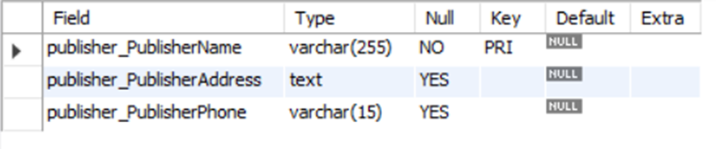
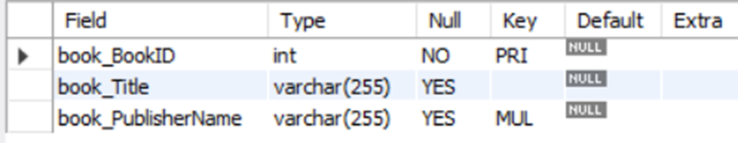
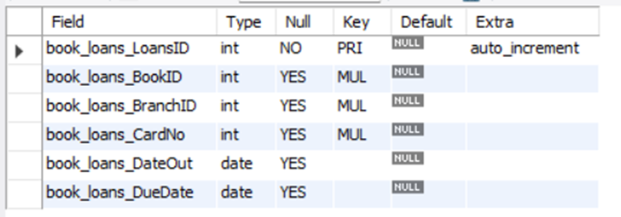
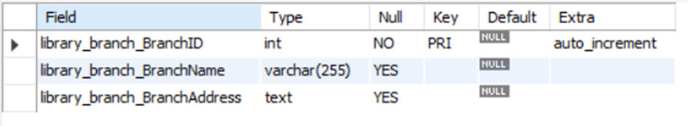
Tables
Publisher
Books
Book Loans
Library Branches

Slide 5
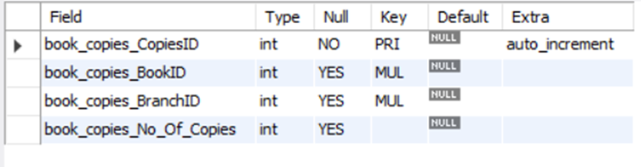
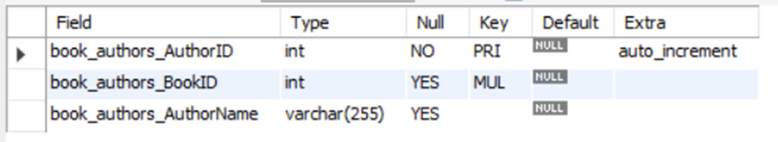

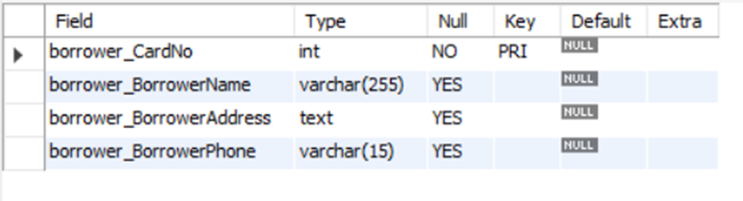
Tables
Book Authors
Book Copies
Book Borrowers

Slide 6
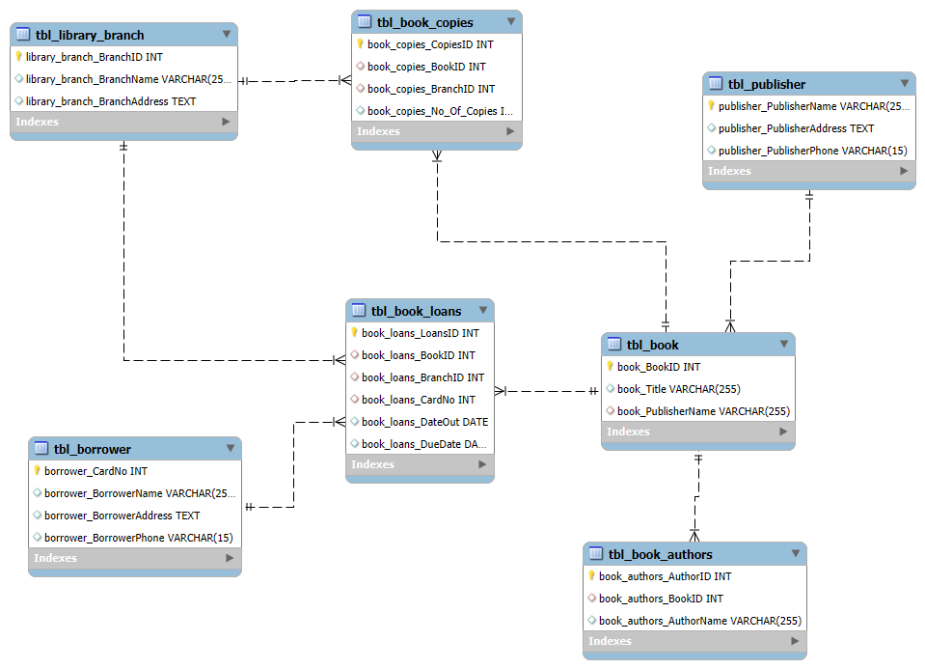
ER Diagram

Slide 7
Problem Statement
Libraries often struggle with managing large volumes of books and borrower records manually.
Tracking which book belongs to which branch can be confusing without a proper system.
Borrower details and loan history are hard to maintain without a digital solution.
There’s no easy way to know how many copies of a book are available at each branch.
Publishers and authors are not always linked clearly to the books they provide.
Manual systems can lead to errors, delays, and lost information.
A well-designed database can solve these issues by making everything organized and searchable.

Slide 8
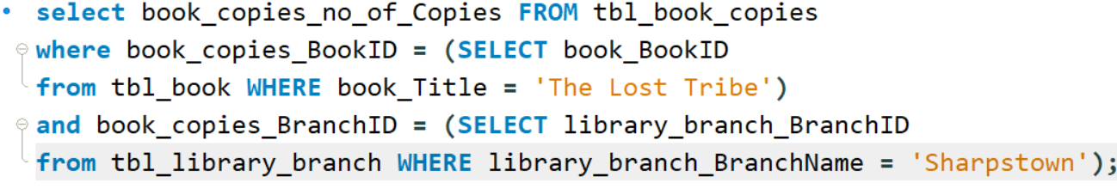

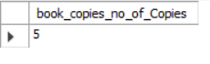
1. How many copies of the book titled "The Lost Tribe" are owned by the library branch whose name is "Sharpstown"?

Slide 9
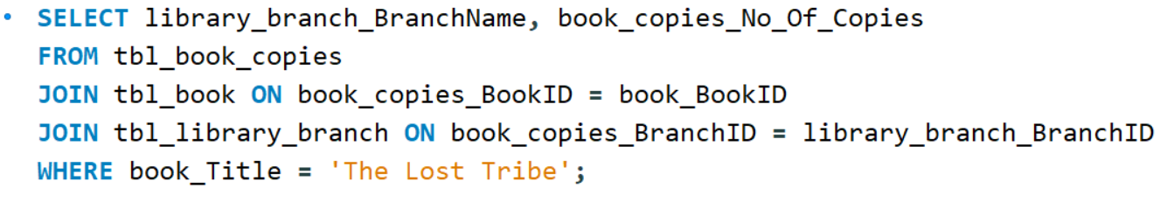

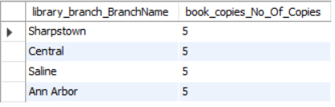
2. How many copies of the book titled "The Lost Tribe" are owned by each library branch?

Slide 10
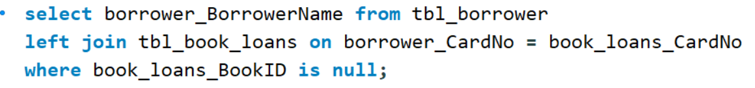
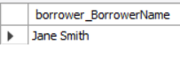

3. Retrieve the names of all borrowers who do not have any books checked out.

Slide 11
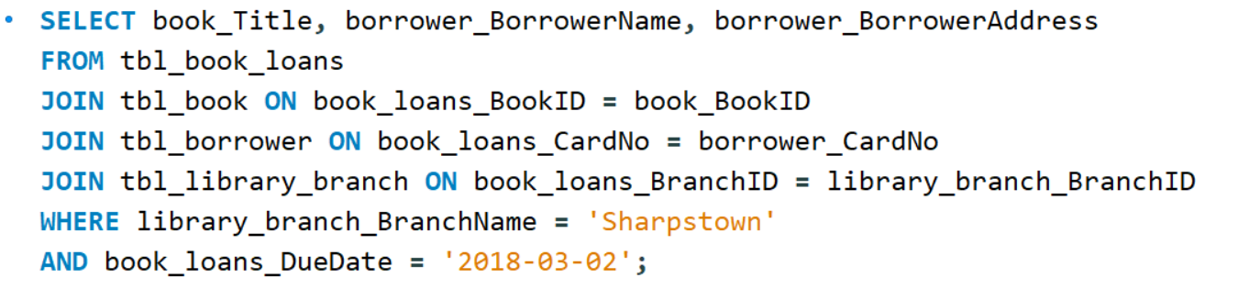

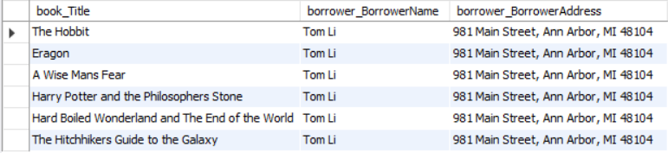
4. For each book that is loaned out from the "Sharpstown" branch and whose DueDate is 2/3/18, retrieve the book title, the borrower's name, and the borrower's address.

Slide 12
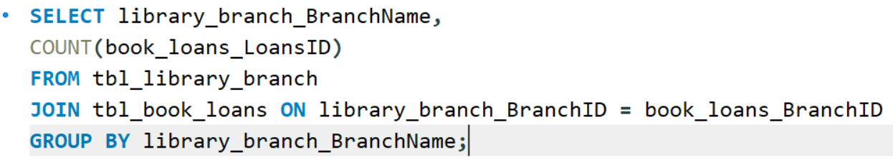

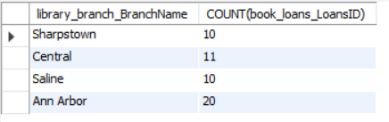
5. For each library branch, retrieve the branch name and the total number of books loaned out from that branch.

Slide 13
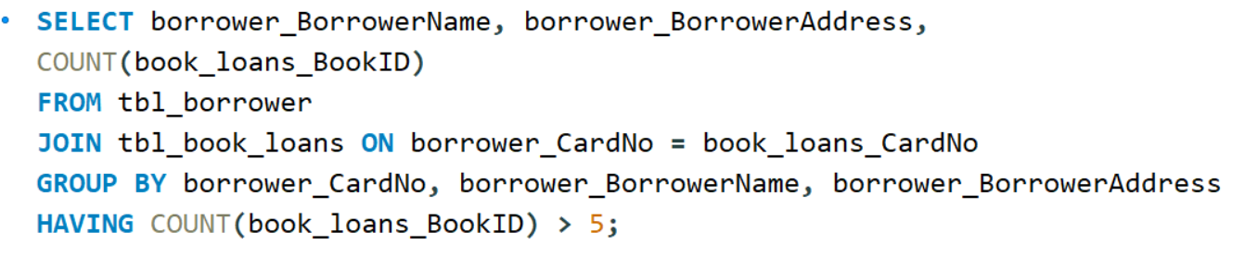

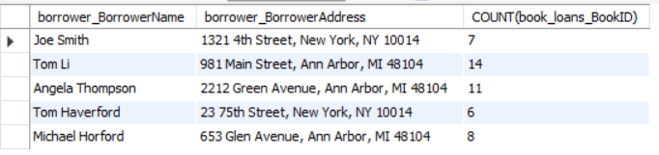
6. Retrieve the names, addresses, and number of books checked out for all borrowers who have more than five books checked out.

Slide 14
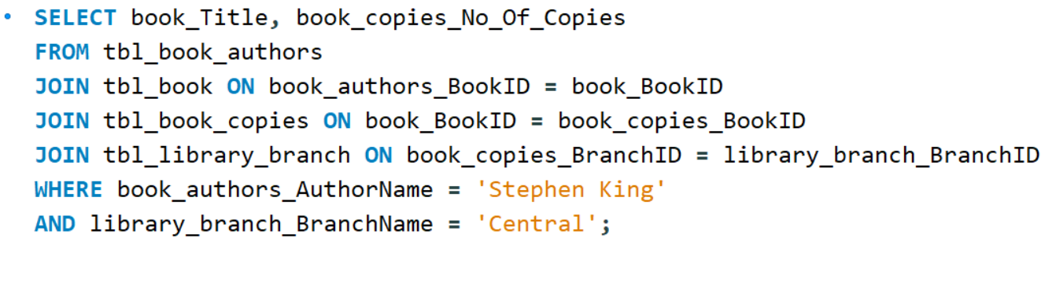


7. For each book authored by "Stephen King", retrieve the title and the number of copies owned by the library branch whose name is "Central".

Slide 15
Conclusion
The Library Management System makes it easier to manage books, borrowers, and branches in a structured way.
It reduces manual work and improves accuracy in tracking loans, copies, and user details.
By linking books to authors and publishers, the system keeps all records organized and searchable.
Each branch can operate independently while still being part of a connected system.
Borrowers benefit from faster service and better access to books across branches.
Overall, this project helps libraries run more smoothly and serve readers more effectively.

Slide 16

THANK YOU
Group Members:
S. V. V. Satyanarayana
R. Guru Pavan Kumar
K. Uday Kumar

